Slide 1
IOT BASED SMART CART WITH INVENTORY MANAGEMENT
ECS1002-Engineering Clinics
FINAL REPORT
GROUP MEMBERS:
22MIC7179 - UMESH MEENA
22MIC7141 - NUPOOR KUMARI
22MIC7163 - NALLA SAI SHIVAMANI
22MIS7159 - MULLAPUDI BHUVANESWARI
22BCE8048 - AMITABHA NATH
22BCE9667 - KOYILADA PREM
FACULTY:
DR. CHIRANJEEV KUMAR SHAHU
DEPARTMENT OF MATHEMATICS

Slide 2
Identification of problem
The traditional shopping experience often faces challenges such as inefficient inventory management, manual product scanning, and long checkout queues. These limitations result in a time-consuming and frustrating process for both customers and retailers.
Key problems to be addressed include:
Inefficient Inventory Management: This inefficient process can result in out-of-stock situations, unsatisfied customers, and revenue loss for retailers.
Time-consuming Product Scanning: The conventional method of scanning products at the checkout counter requires individual item scanning, which can be time-consuming and prone to errors. This process often leads to long queues and customer dissatisfaction.
Limited Customer Engagement: Traditional shopping experiences lack personalized interactions and tailored recommendations. Customers are often unaware of product details, special offers, or complementary items that may enhance their shopping experience and meet their preferences.
Ineffective Supply Chain Optimization: Retailers face challenges in optimizing their supply chain processes, including restocking, inventory forecasting, and waste reduction. The lack of real-time data on product availability and customer preferences hinders their ability to streamline operations and minimize stockouts.

Slide 3
Key objectives of the project :
Real-time Inventory Management:
Enable automatic tracking of inventory levels in real-time by utilizing RFID technology.
Provide instant updates on product availability and stock levels to both customers and retailers.
Reduce instances of out-of-stock situations, ensuring customer satisfaction and minimizing revenue loss for retailers.
Efficient and Quick Checkout Process:
Implement a streamlined checkout process by utilizing RFID tags for automatic product identification.
Eliminate the need for manual scanning at the checkout counter, reducing waiting times for customers.
Improve the overall shopping experience by minimizing queues and enhancing operational efficiency for retailers.
Enhanced Customer Engagement:
Utilize the Web interface to provide customers with personalized interactions and tailored recommendations.
Display product details, prices, and additional information on the LCD display for customer awareness.
Enhance the overall shopping experience by informing customers of special offers, complementary items, and relevant product information.
Optimized Supply Chain Processes:
Facilitate effective supply chain optimization by providing real-time data on product availability and customer preferences.
Support retailers in making informed decisions related to restocking, inventory forecasting, and waste reduction.
Improve overall supply chain efficiency by leveraging IoT technology to gather and analyze data for better decision-making.

Slide 4
5.User-friendly Interface:
Develop a user-friendly interface on the LCD display for easy interaction with the Smart Basket.
Ensure clear and concise presentation of scanned product details, including name, price, and any additional information.
Enhance the overall usability of the Smart Basket, making it accessible and intuitive for a wide range of users.
6.Integration of Payment System:
Incorporate the integrated payment system to allow users to make payments directly through the Smart Basket.
Eliminate the need for waiting in line at the checkout counter, providing a convenient and time-saving payment experience for customers.
7.Implementation of IoT Technology:
Utilize Arduino as the central control unit, managing communication between various components.
Leverage RFID technology to enable seamless product identification and data retrieval.
Ensure the integration of Wi-Fi capabilities (esp 8266) for data exchange and connectivity with external databases and the Website.
8.Error Reduction and Accuracy:
Minimize errors associated with manual scanning by implementing RFID technology for automatic product identification.
Enhance the accuracy of inventory management and checkout processes, reducing instances of miscounts and data discrepancies.
By addressing these key objectives, IOT BASED SMART CART WITH INVENTORY MANAGEMENT aims to revolutionize the traditional shopping experience, providing a more efficient, engaging, and technology-driven approach for both customers and retailers.

Slide 5
BLOCK DIAGRAM :
TROLLEY SECTION:
POWER SUPPLY
MICRO CONTROLLER
(AT89S52)
RF TRANSMITTER
HT12E ENCODER
LCD
RFID TAG
RFID
READER
MAX 232

Slide 6
BLOCK DIAGRAM :
BILLING SECTION:
MICRO CONTROLLER
(AT89S52)
POWER SUPPLY
RF RECEIVER
KEYPAD
HT12D DECODER
PC

Slide 7
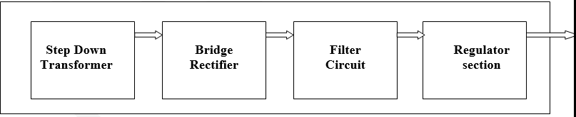
BLOCK DIAGRAM :
POWER SUPPLY:

Slide 8
IDENTIFICATION OF REQUIRED COMPONENTS AND BUDGET ESTIMATIOM
HARDWARE REQUIRED
Serial Number | Components | Quantity | Price(₹)
1 | NodeMCU ESP8266 Wi-Fi | 1 | 500
2 | RFID card | 5 | 200
3 | RFID Reader EM-18 Board | 1 | 1200
4 | LM2596S DC to DC Step Down Module | 1 | 200
5 | IM900A GSM Modem with SMA Antenna (GSM Module) | 1 | 1200
6 | RF transmitter | 1 | 300
7 | RF receiver | 1 | 300
8 | LCD 16x2 | 1 | 500
9 | 3.7v 2000mah 18650 lithium(Li) ion cells | 4 | 1000
10 | Battery charger | 1 | 500
 | Total |  | 5900

Slide 9
SOFTWARE REQUIRED
Arduino IDE

Slide 10
PLAN OF ACTION
Project Initiation:
Hardware Procurement:.
Software Setup:.
Arduino Programming:
RFID Integration:
User Interface Design:
Web Development
Testing and Debugging:
Maintenance and Updates
Documentation

Slide 11
Timeline of the updates
1st FEBRUARY,2024 to 3rd FEBRUARY,2024
Review I
Presentation
19th MARCH,2024 to 23rd March,2024
Review II
Submission of prototype
23rd APRIL,2024 to 27th APRIL,2024
Review III
Submission of final model
30th APRIL,2024
FINAL REPORT
Submission of final report

Slide 12

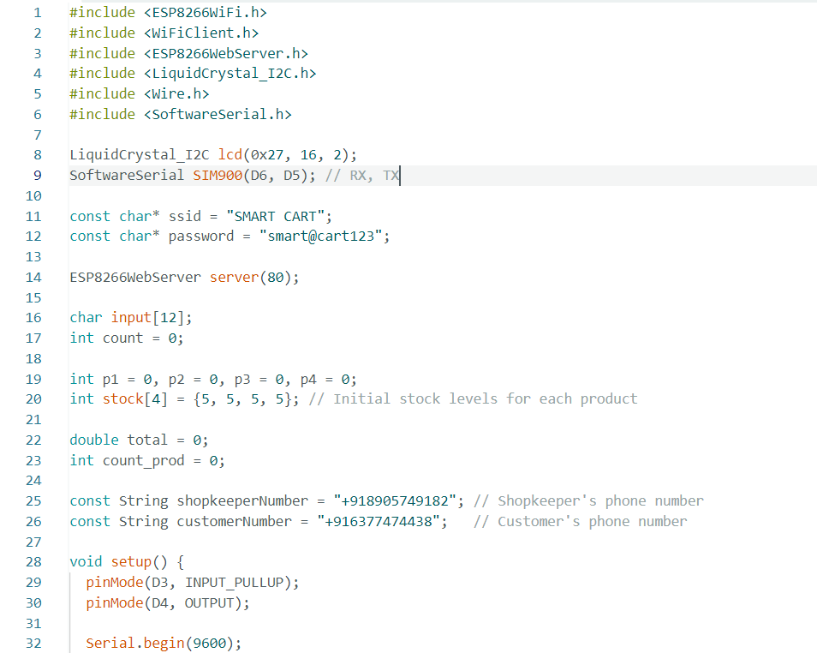

Slide 13
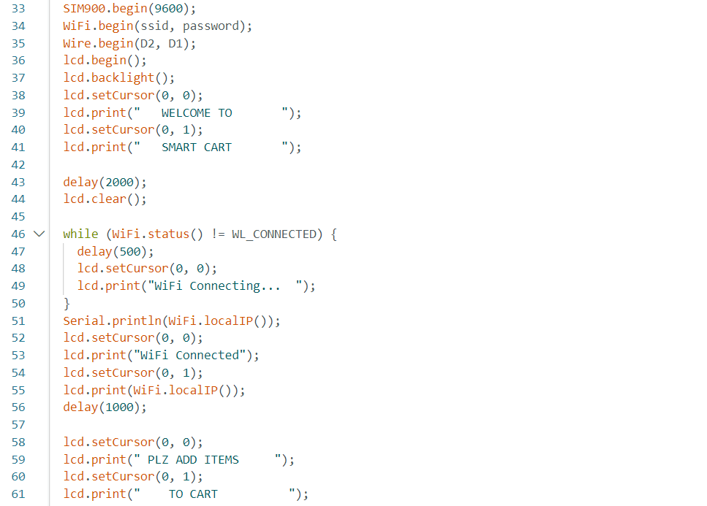

Slide 14
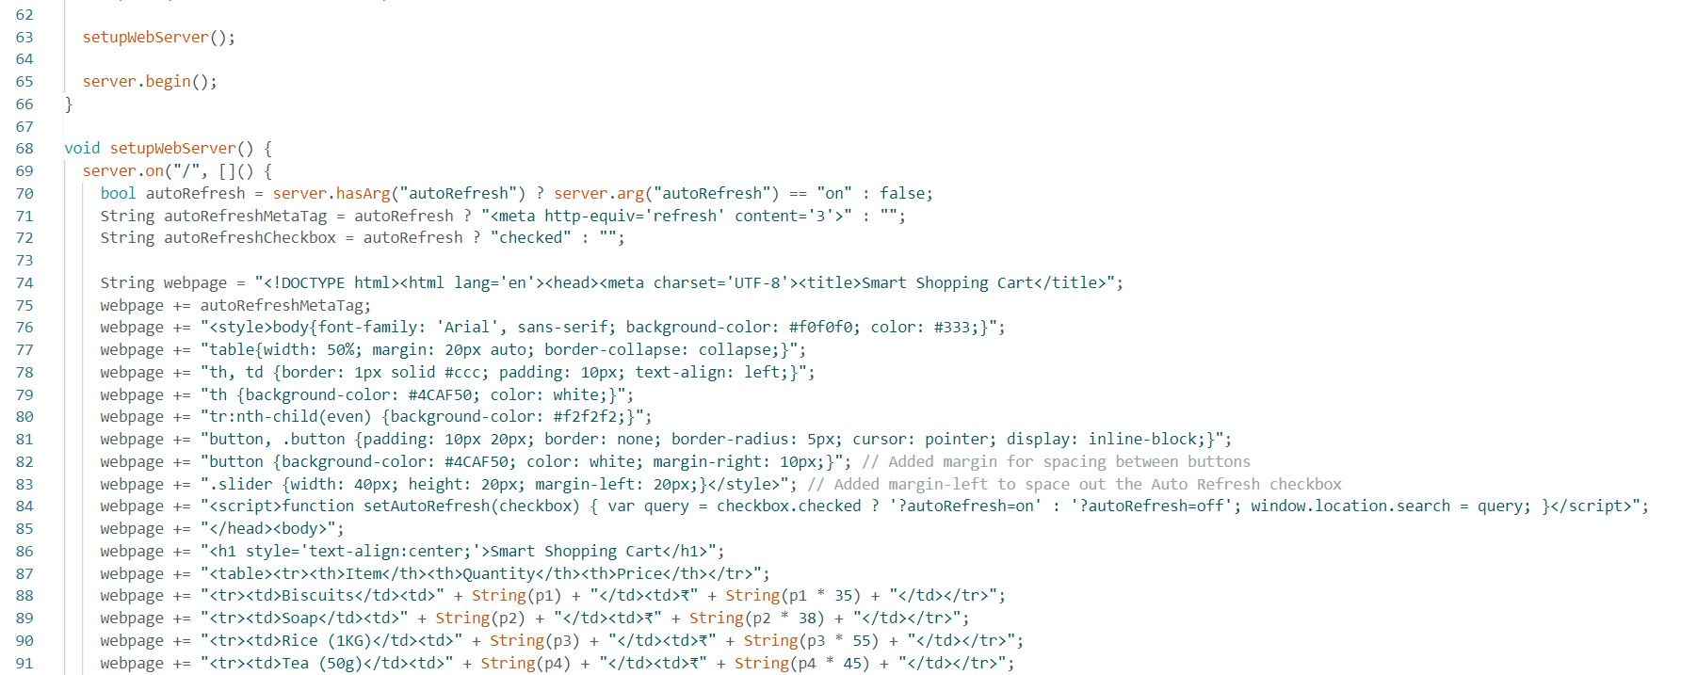

Slide 15
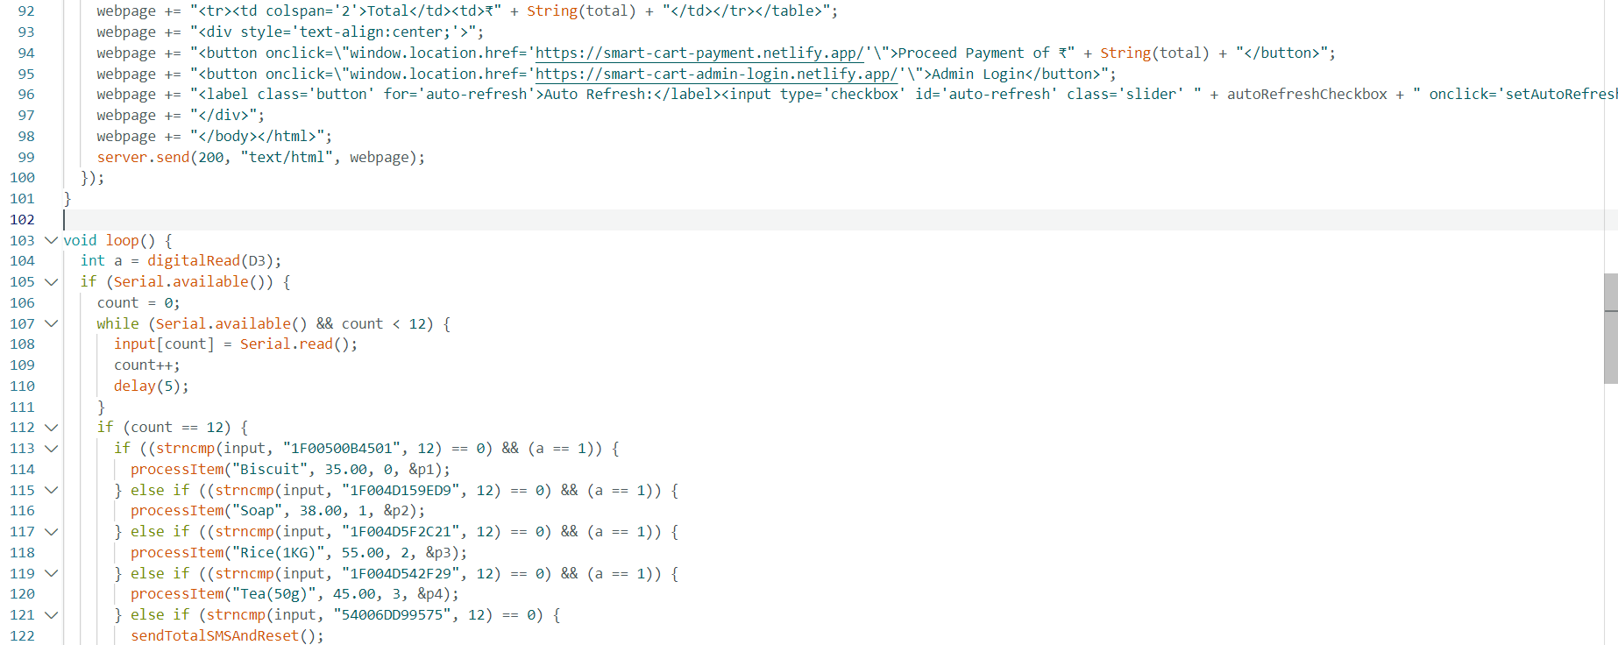

Slide 16
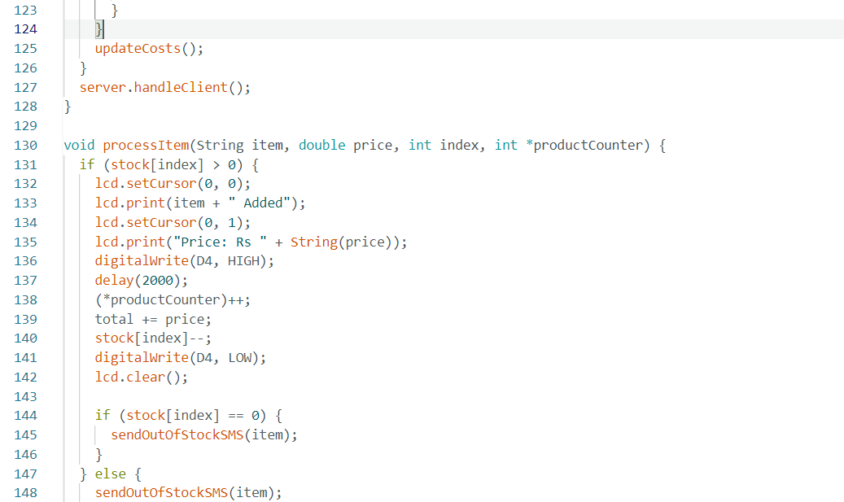


Slide 17
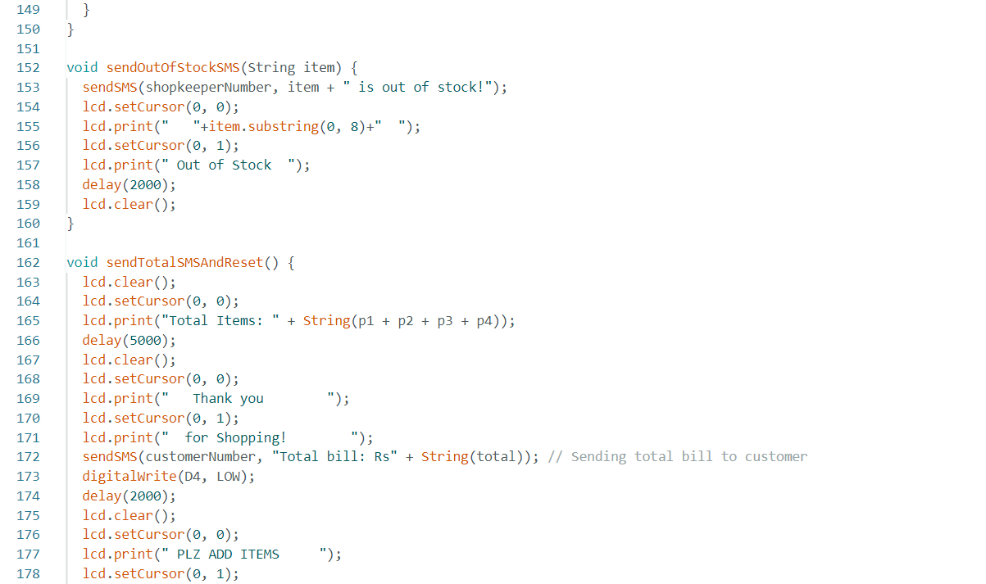

Slide 18
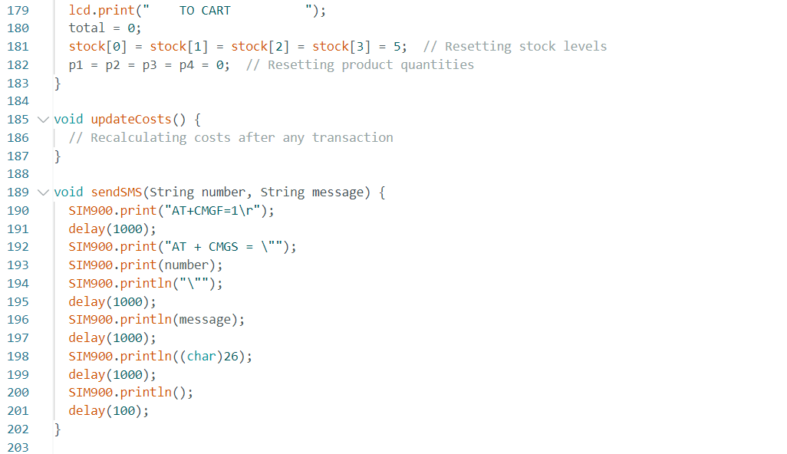

Slide 19
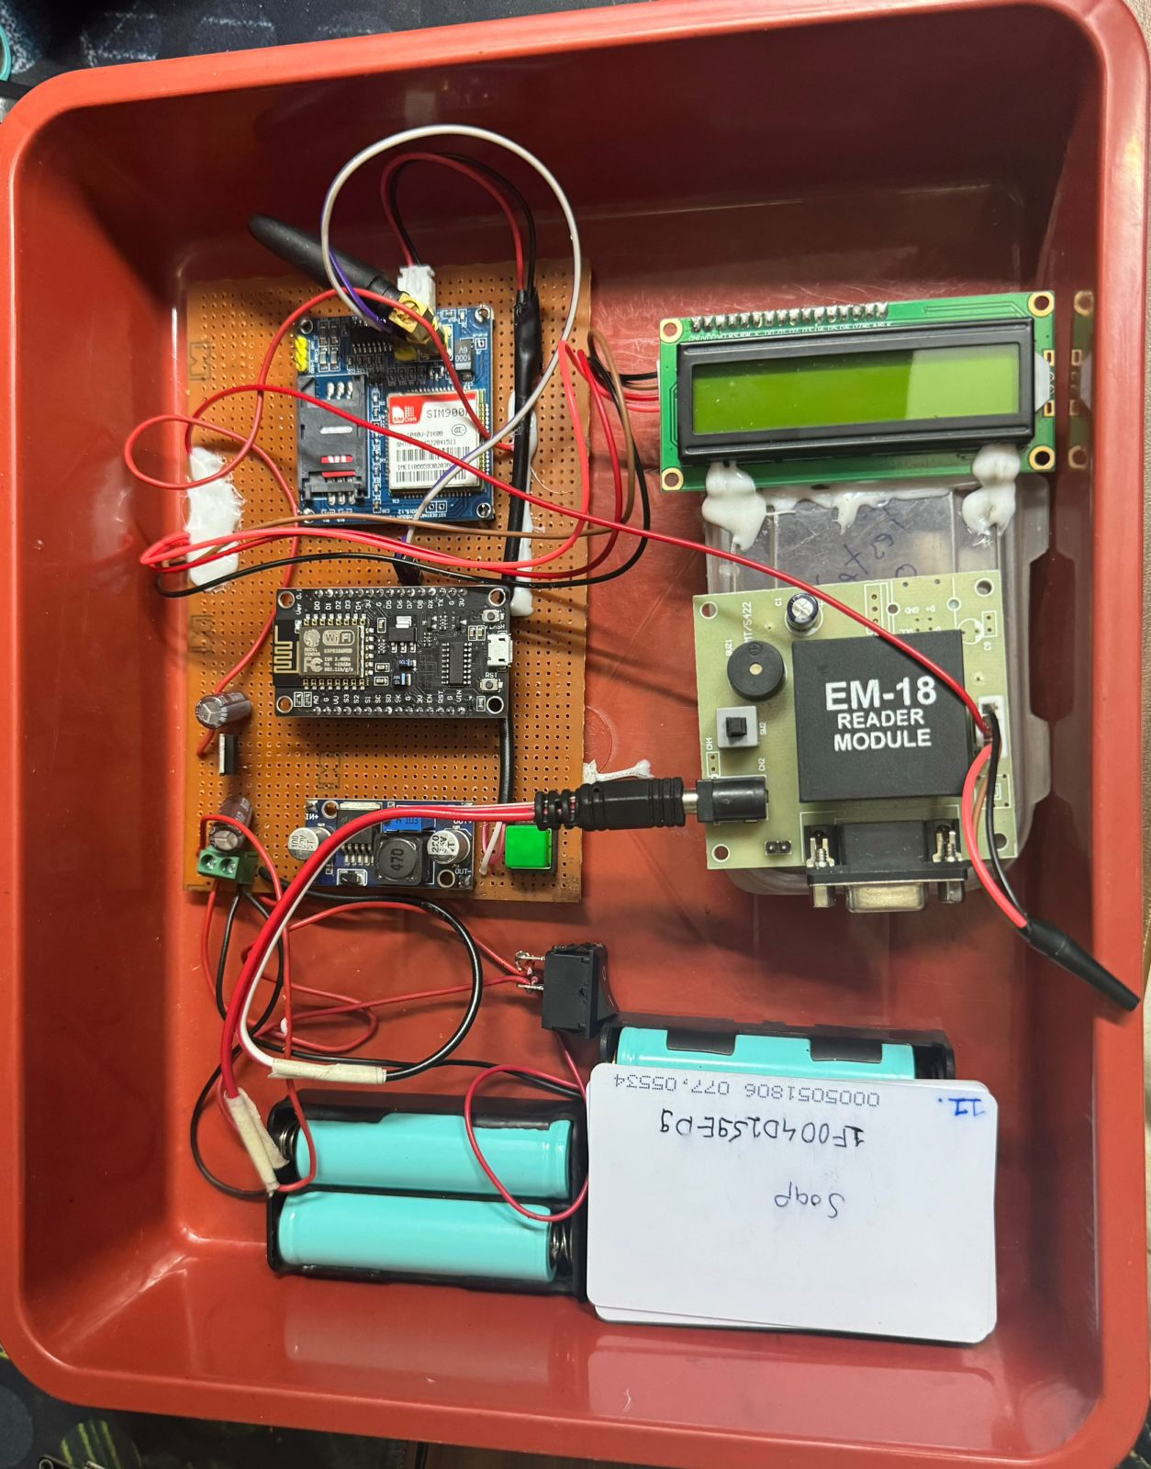

▪

Slide 20
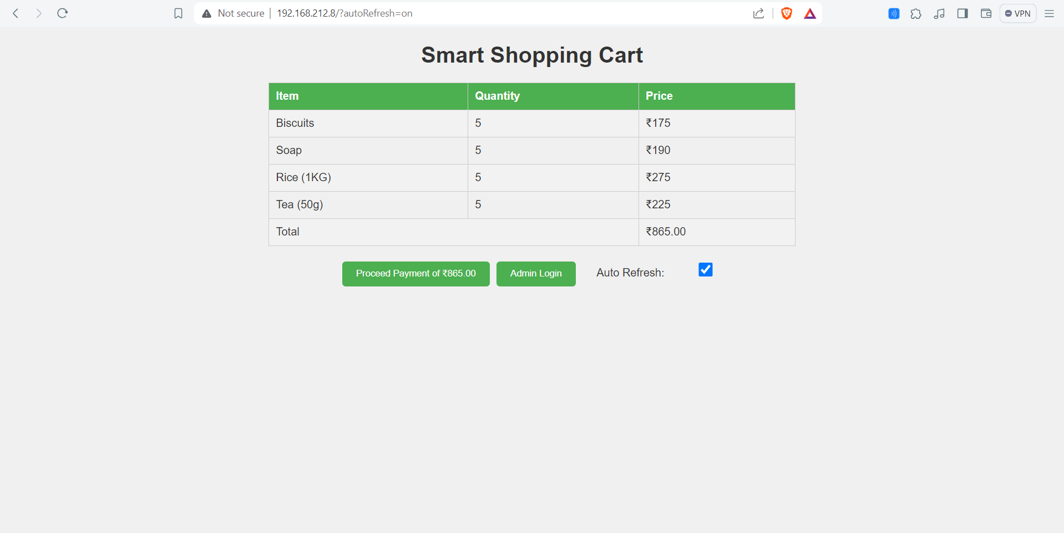

Slide 21
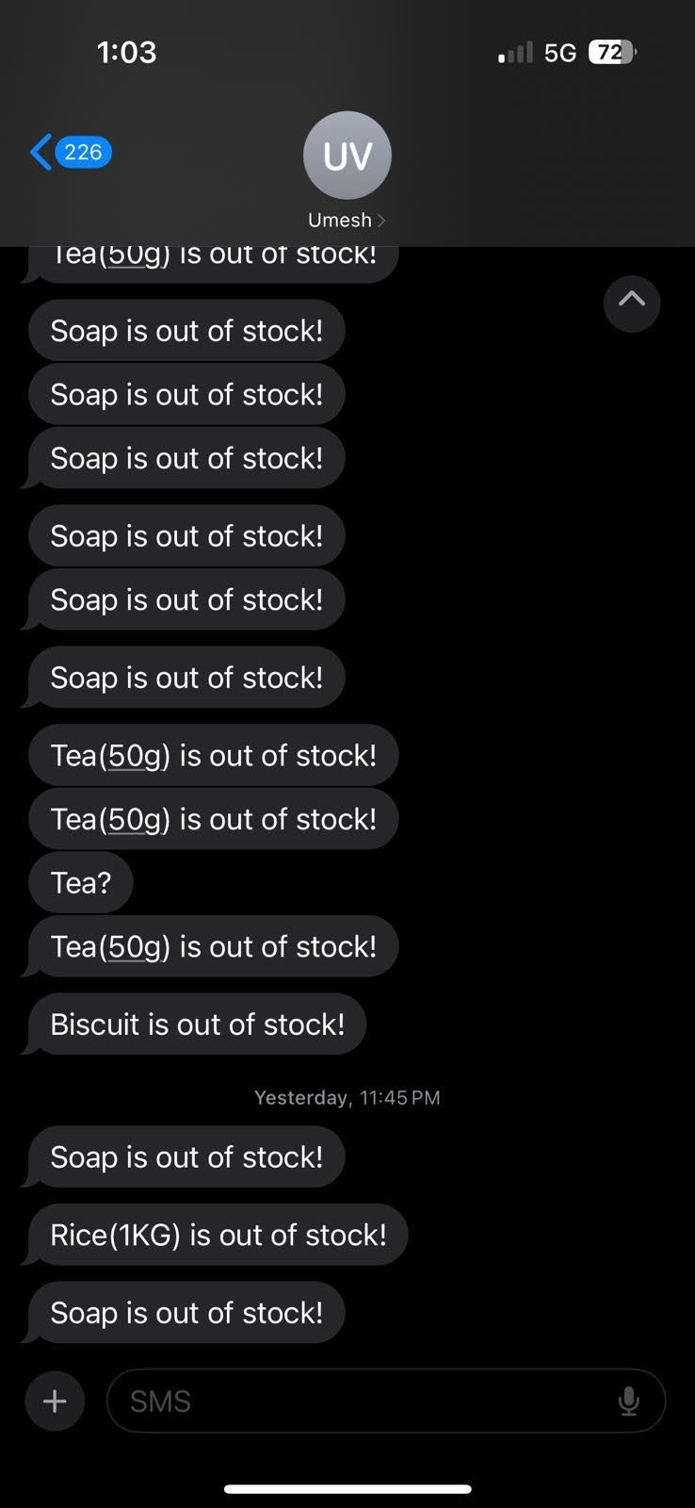
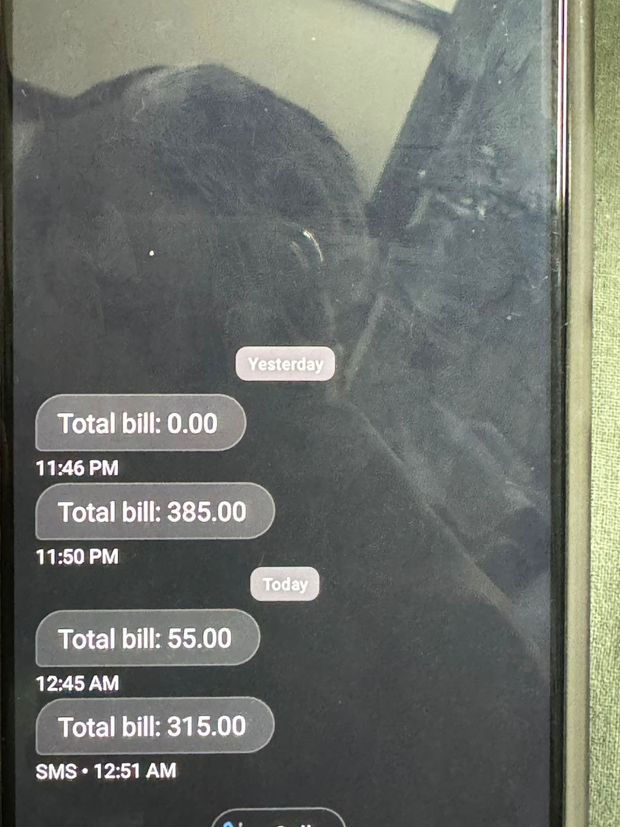

Slide 22
Changes made:
1.Fixed frequent restart of setup
2. Fixed webpage(now optimized)
3. Fixed sms triggering issue
4. Added autorefresh button in webpage
5. Added Static payment page
https://smart-cart-payment.netlify.app/

Slide 23
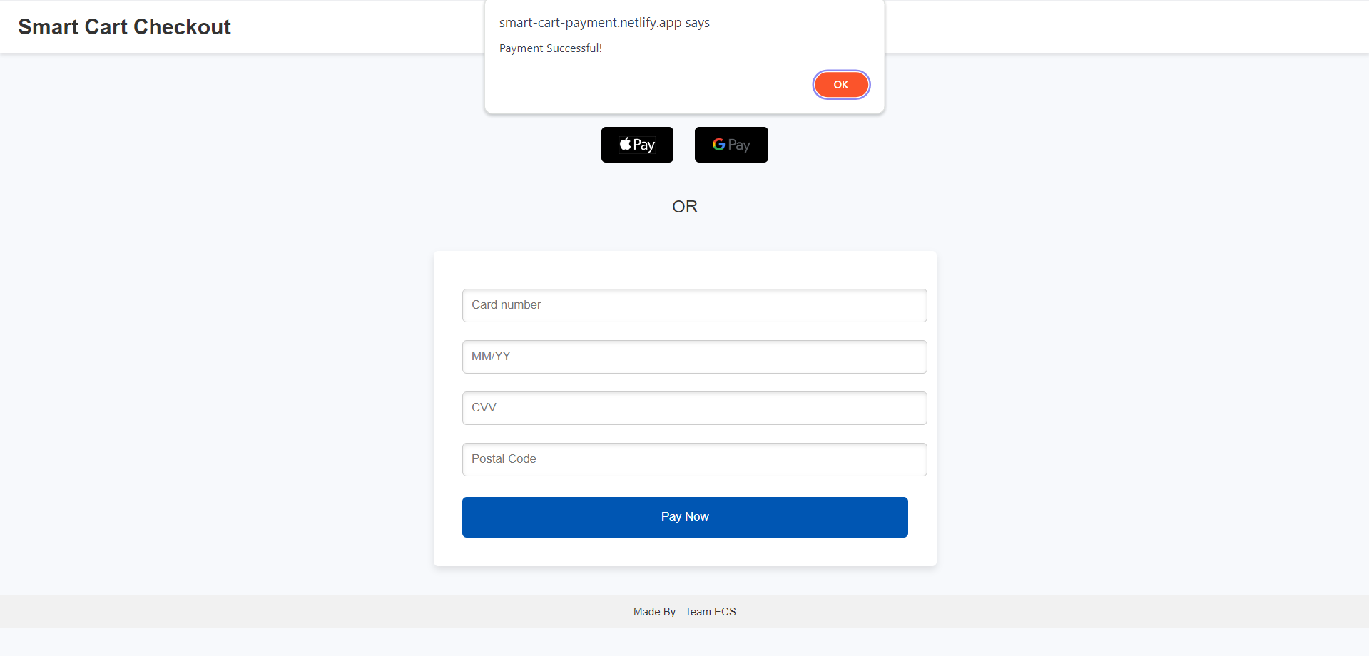

Slide 24

6. Added thank you page when payment completes
https://smart-cart-ty.netlify.app/

Slide 25
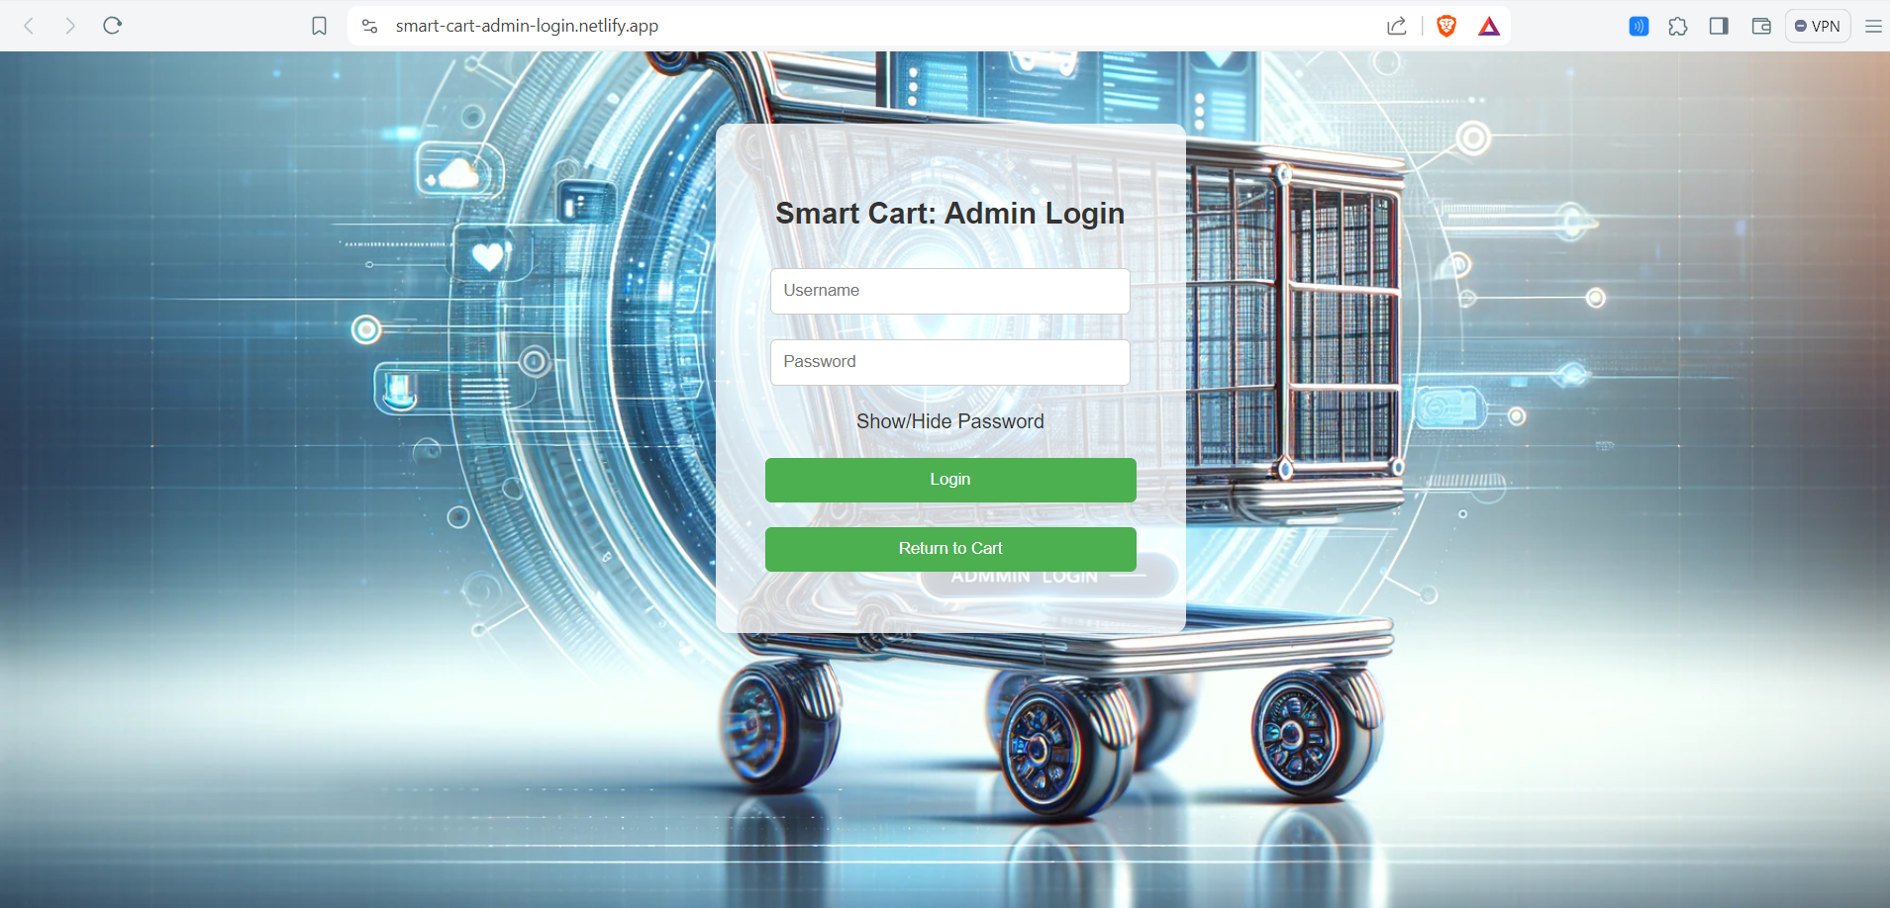
7. Added Admin(Owner) login to access Admin panel
Credentials to login*
Username- admin
Password - admin
Unable to login if entered wrong credentials
https://smart-cart-admin-login.netlify.app/

Slide 26
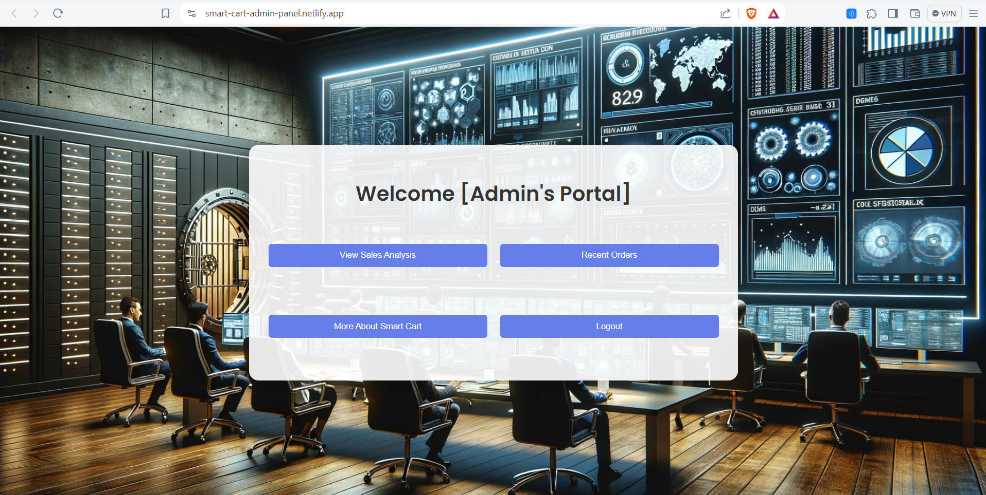
8. Added Admin Panel with features
https://smart-cart-admin-panel.netlify.app/

Slide 27
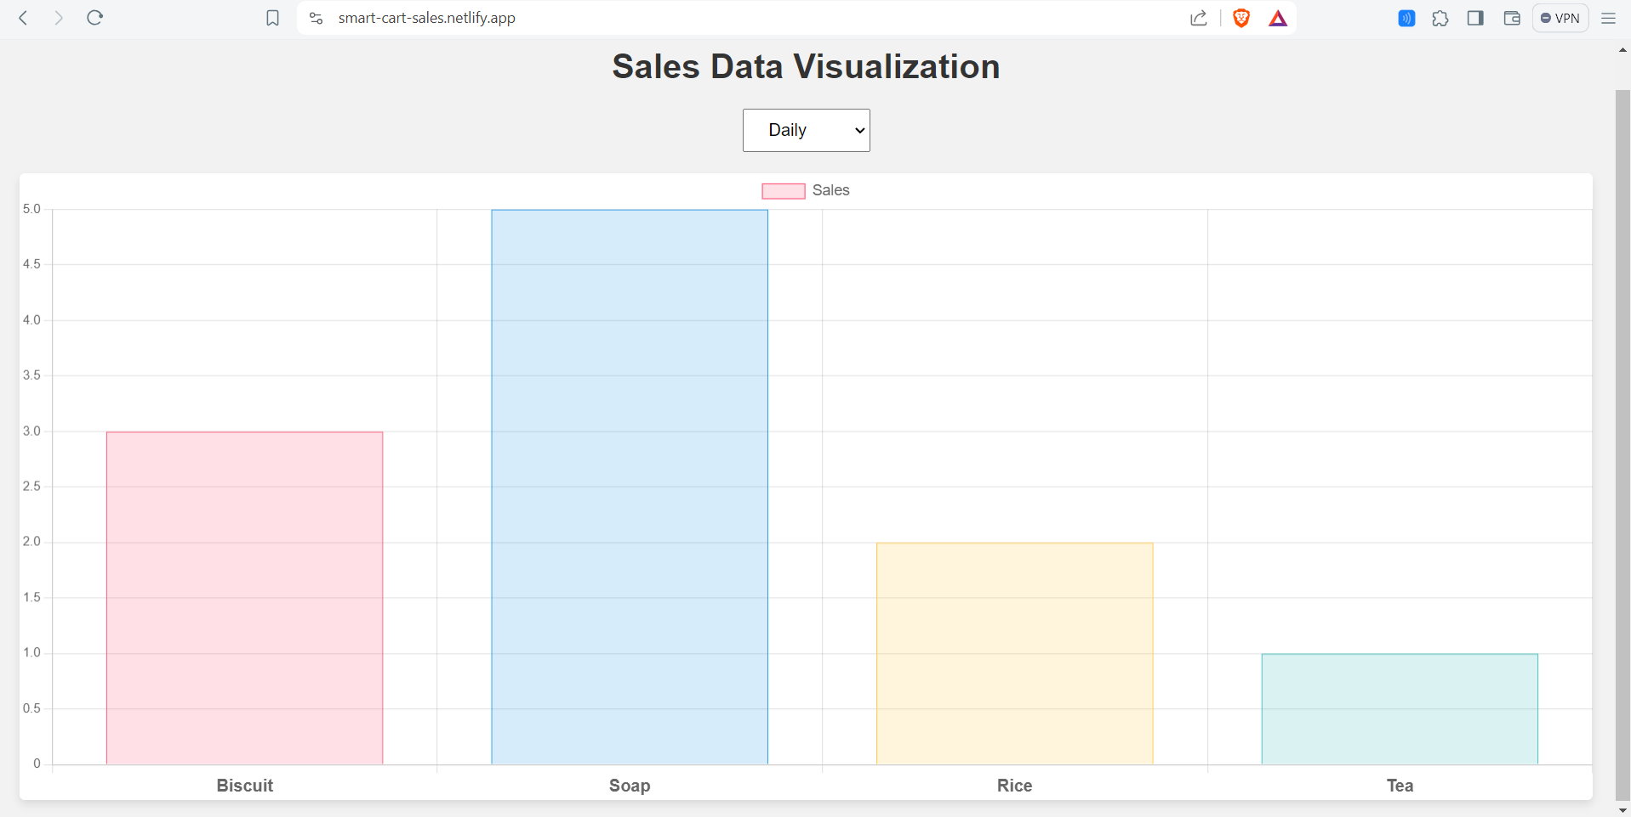
9.Added Sales Analysis with daily/monthly/yearly basis
https://smart-cart-sales.netlify.app/
Daily mode:

Slide 28
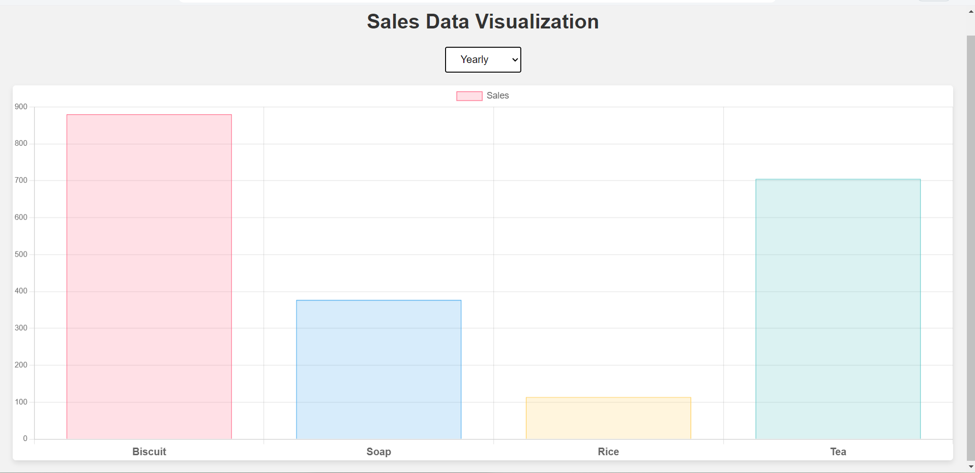
Yearly mode:

Slide 29
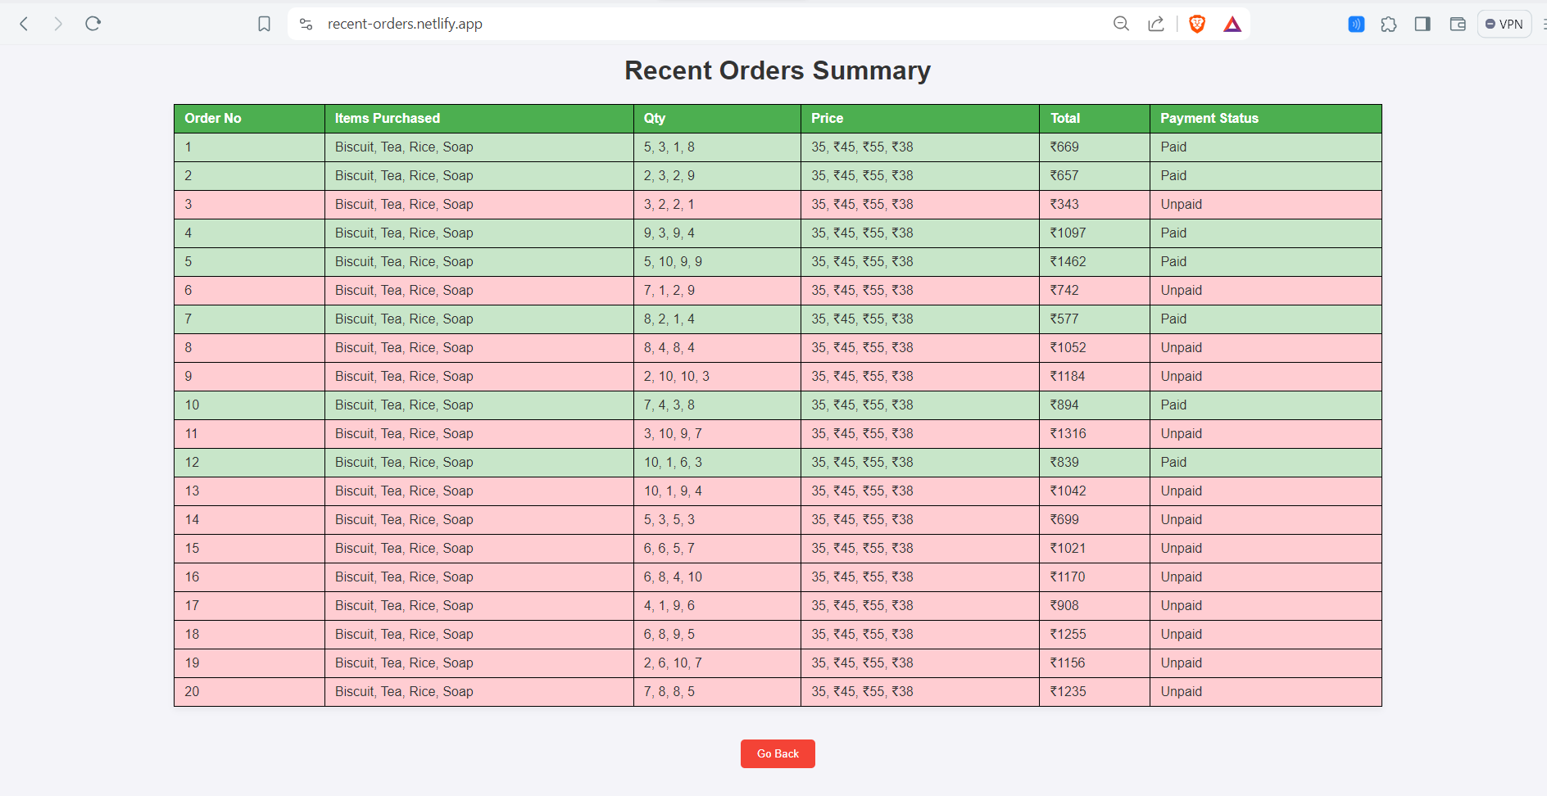
10. Added static option to see recent orders
https://recent-orders.netlify.app/

Slide 30
Conclusion
In conclusion, Iot based smart cart with inventory management represents a transformative solution leveraging the power of the Internet of Things (IoT) and RFID technology to revolutionize the traditional shopping experience. By addressing key challenges in inventory management, checkout processes, customer engagement, and supply chain optimization, the Smart Basket aims to bring efficiency, convenience, and innovation to both customers and retailers.
The integration of RFID technology allows for real-time inventory management, reducing the likelihood of out-of-stock situations and enhancing customer satisfaction. The streamlined checkout process, facilitated by automatic product identification, minimizes waiting times and improves overall operational efficiency for retailers.
Furthermore, the project focuses on enhancing customer engagement through a user-friendly interface and website. This enables personalized interactions, tailored recommendations, and access to relevant product information, fostering a more enjoyable and informative shopping experience.
The Smart Shopping Basket's contribution to supply chain optimization is notable, providing retailers with valuable real-time data for informed decision-making related to restocking, inventory forecasting, and waste reduction.
The successful implementation of this project involves a meticulous plan of action, from hardware procurement to deployment, user training, and ongoing maintenance. The development of a secure and efficient integrated payment system adds an extra layer of convenience for users, allowing them to make transactions directly through the Smart Basket.
In essence, the IoT Smart Shopping Basket project signifies a step forward in modernizing retail operations, showcasing the potential of IoT technology to bring about positive changes in how businesses manage inventory, engage with customers, and optimize supply chain processes. As the retail landscape continues to evolve, such innovative solutions hold the promise of creating a more seamless, efficient, and satisfying shopping experience for consumers while empowering retailers with enhanced operational capabilities.

Slide 31
References
https://www.researchgate.net/publication/317932719_DESIGN_OF_AN_INTELLIGENT_SHOPPING_BASKET_USING_IoT
https://ieeexplore.ieee.org/stamp/stamp.jsp?tp=&arnumber=9045336
https://www.jetir.org/papers/JETIR1903933.pdf
http://www.kresttechnology.com/krest-academic-projects/krest-major-projects/ECE/BTech%20MINI%20ECE%20EMBEDDED%202019/BTech%20MINI%20ECE%20EMBEDDED%20ABSTRACTS%202019/55.SMART%20SHOPPING%20CART%20INFO.docx
https://www.youtube.com/watch?v=N8sdWydeZqs

Slide 32
THANK YOU

